Slide 1

Machine learning algorithm
Team members:
ALAGUTAMIL N(927622BAL001)
GAUSIKA K M(927622BAL010)
KARISHMA S K(927622BAL020)
MUTHUVEL A S(927622BAL030)

Slide 2

Title Implementation of Decision Trees for Credit Scoring in Finance

Slide 3

Introduction
Introduction to credit scoring as the process of assessing the creditworthiness of individuals or entities seeking financial services
In the intricate world of finance, the ability to accurately assess creditworthiness stands as a cornerstone for prudent decision-making.
The process of evaluating the credit risk of potential borrowers, plays a pivotal role in this realm.
Traditionally, financial institutions have relied on rule-based systems or statistical models for credit scoring.
However, with the advent of machine learning, particularly decision tree algorithms, there's been a significant paradigm shift.

Slide 4

What is credit scoring?
Credit scoring is a statistical method used by lenders to evaluate the creditworthiness of individuals or entities seeking access to financial products or services,
Such as loans, credit cards, or mortgages.
It involves analyzing various factors and historical data related to a borrower's financial behavior, credit history, and repayment patterns to assess the likelihood of repayment of debt obligations.
Importance of credit scoring in finance
Facilitating lending decisions
Mitigating credit risk
Enhancing financial stability

Slide 5
Introduction to Decision Trees
Decision trees are a fundamental supervised learning algorithm used for both classification and regression tasks in machine learning.
They are graphical models that represent a flowchart-like structure where each internal node represents a feature or attribute, each branch represents a decision or rule based on that feature, and each leaf node represents the outcome or class label.
Decision trees are known for their simplicity, interpretability, and flexibility, making them particularly suitable for tasks where understanding the rationale behind predictions is important.
Additionally, decision trees can be easily visualized, allowing users to gain insights into the underlying decision-making process.

Slide 6
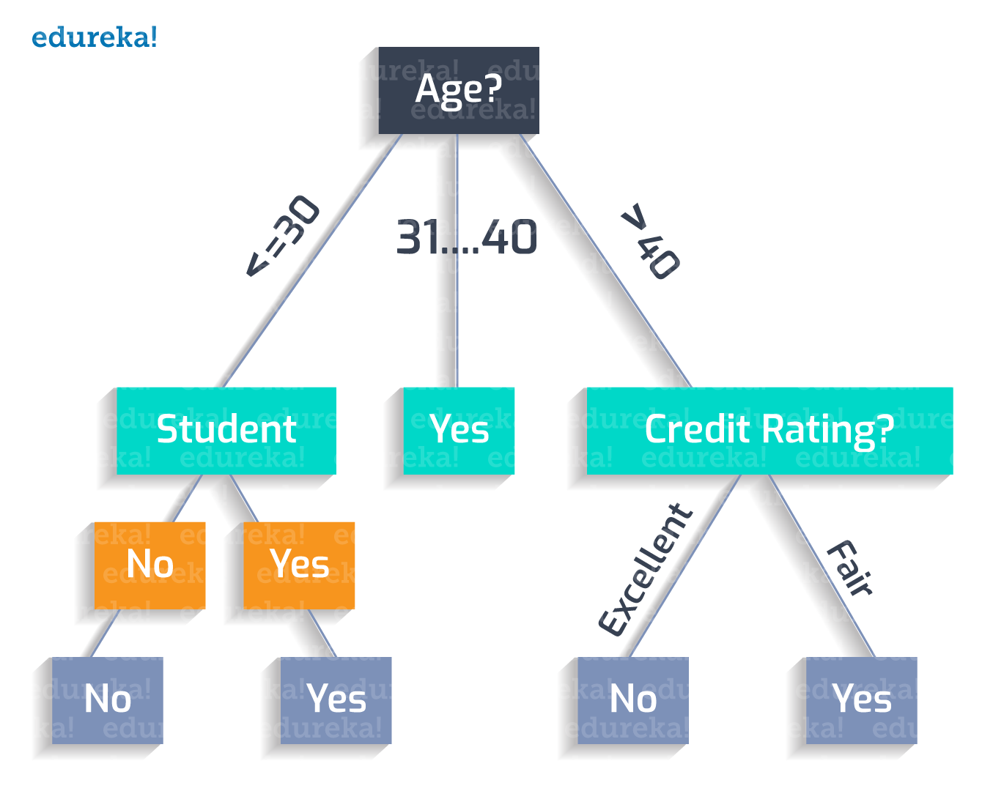
Relevance of decision trees in credit scoring
Transparency and interpretability
Ability to handle complex decision-making scenarios

Slide 7
Machine Learning Pipeline
In the context of machine learning, decision trees are constructed recursively by partitioning the feature space into smaller subsets based on the values of features, with the goal of maximizing the predictive accuracy or minimizing the impurity within each subset.
Overview of the machine learning pipeline for credit scoring with decision trees are
Data collection and preprocessing
Model training
Model evaluation and validation
Deployment and monitoring

Slide 8
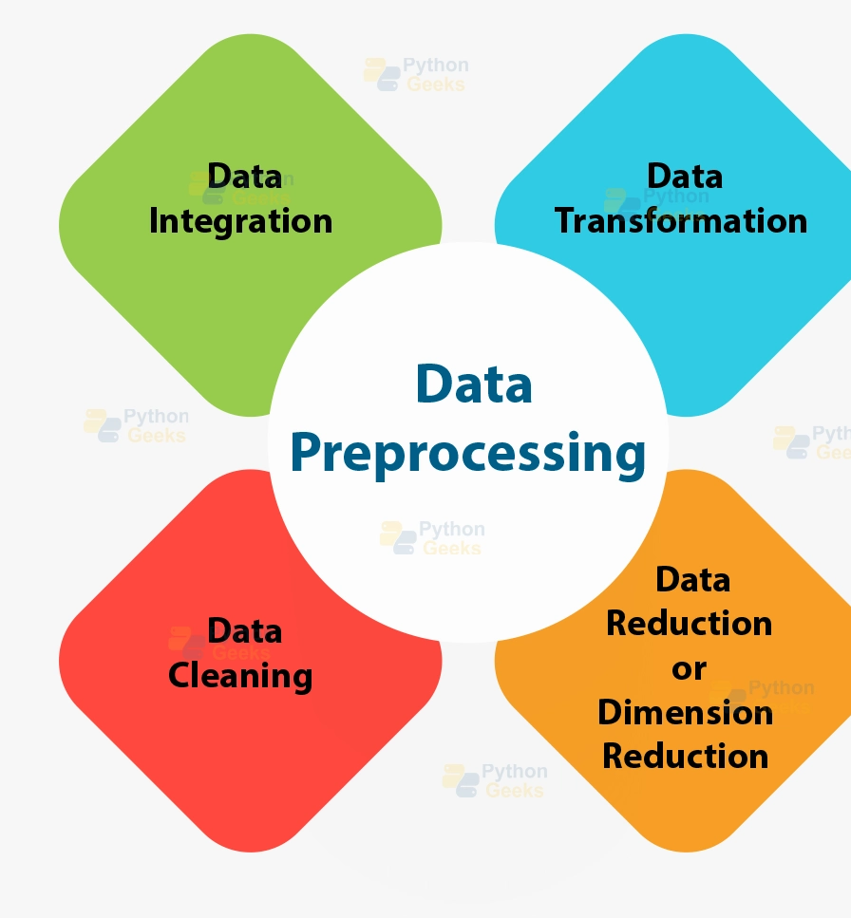
Data Preprocessing
Data preprocessing is a crucial step in the machine learning pipeline that involves cleaning, transforming, and preparing raw data to make it suitable for modeling.
In the context of credit scoring and decision trees, data preprocessing ensures that the input data is of high quality, consistent, and compatible with the algorithms used for training and evaluation.

Slide 9
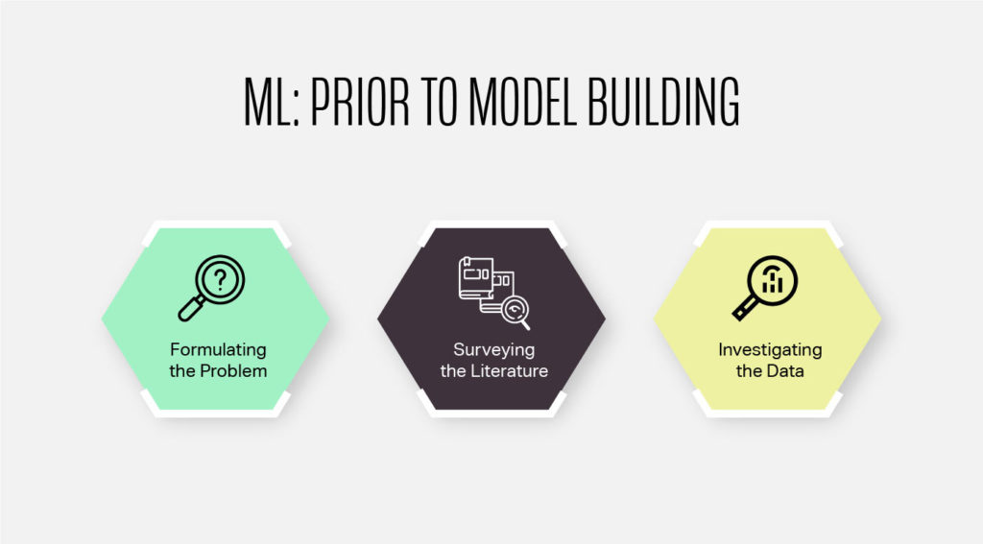
Model Building
Model building is the process of constructing a predictive model using machine learning algorithms to make predictions or decisions based on input data.
In the context of credit scoring with decision trees, model building involves selecting appropriate features, training the decision tree model, and optimizing its performance

Slide 10
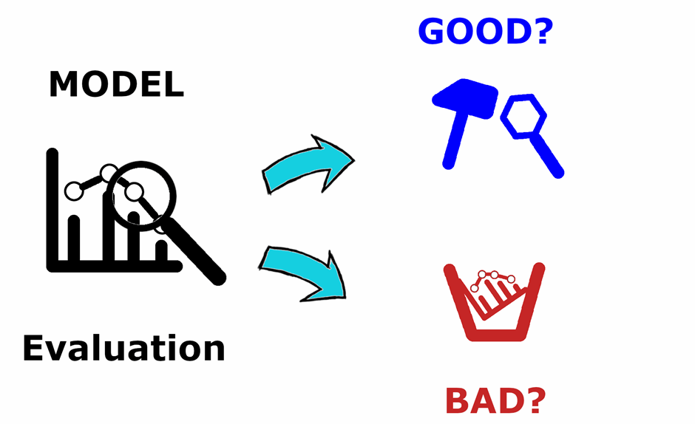
Model Evaluation
Model evaluation is a critical step in the machine learning pipeline that assesses the performance of a trained model using a separate dataset from the one used for training.
In the context of credit scoring with decision trees, model evaluation helps determine how well the model generalizes to unseen data and whether it meets the desired performance criteria

Slide 11
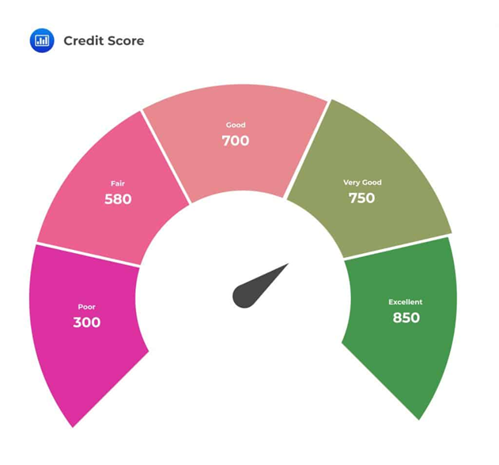
Use case
1. Process automation in corporate finance
The ability to streamline and automate business processes benefits financial companies in several ways. For example, organizations can use these technologies to automate menial tasks such as data input and financial monitoring.
2. Enhanced customer relations
One of the most practical applications of machine learning in finance is in customer relations. Finance companies utilize ML technology like chatbots to improve the customer experience through on-demand help and real-time recommendations.

Slide 12
3. Security analysis and portfolio management (robo-advisors)
Robo-advisors are a notable example of machine learning use cases in finance. They can vary slightly depending on the financial company offering the service. However, the term "robo-advisor" typically refers to online services that provide investment advice and help users create and manage investment portfolios. It's dependent on a wide range of user-input preferences. For example, risk preferences gauge user needs by collecting information about the decisions they would make in the face of unpredictable circumstances.
4. Stock market forecasting
ML technology is often used in the finance industry to predict stock prices and influence trading decisions. It works by using large historical data sets to make predictions about the future. Here are two types of trading that machine learning technology enable:
Algorithmic trading: Identifying patterns and developing trading strategies with speed and accuracy
High-Frequency Trading (HFT): Identifying trading opportunities and executing trades at high speeds

Slide 13
5. Fraud detection
Machine learning models learn from identifying patterns. These patterns help them understand normal behavior and make it easier to detect suspicious activities, like money laundering or insider trading.
6. Online lending platforms and credit scoring
The finance industry uses machine learning tools to assess loan applications and calculate credit scores. Online lending platforms generate real-time reports and recommend loans that are accessible to users based on their financial history.

Slide 14
Conclusion
Decision trees offer a compelling solution for credit scoring in finance, striking a balance between accuracy and interpretability.
Their ability to identify important features, handle large datasets efficiently, and provide transparent decision-making processes makes them invaluable in risk assessment and management.
Regular model validation and potential enhancements with ensemble methods ensure the continued relevance and reliability of decision tree models in supporting informed lending and credit assessment decisions within the financial industry.

